Slide 1
Spatial Sparse CNNs from Masks
Shuyue Jia

Slide 2
Challenges & Problems:
Region of Interest
Attention Mechanism
Image regions are not equally important
Spatial sparsity
Traditional (Dense) Convolutions → high computational cost
Binary masks → Sparse Region of Interest
Practical Speed-up
Many literature: theoretical complexity
Slow inference speed

Slide 3
Related Work (Conditional Execution / NN Gating):
Layer-based methods: Certain network layers or blocks
Adaptive Computation Time ← Stop learning (halting score)
Channel-based methods: Prune channels dynamically
Advanced features are only needed for a subset of the images
Spatial methods:
Glimpse/Cascades → Region of Interest but Lose features
Spatially Adaptive Computation Time (SACT) ← features refinement
SBNet (Two stage): Mask → Tiles
Masks → Attention Mechanism (Weights are binary)

Slide 4
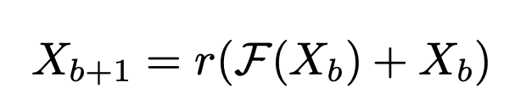
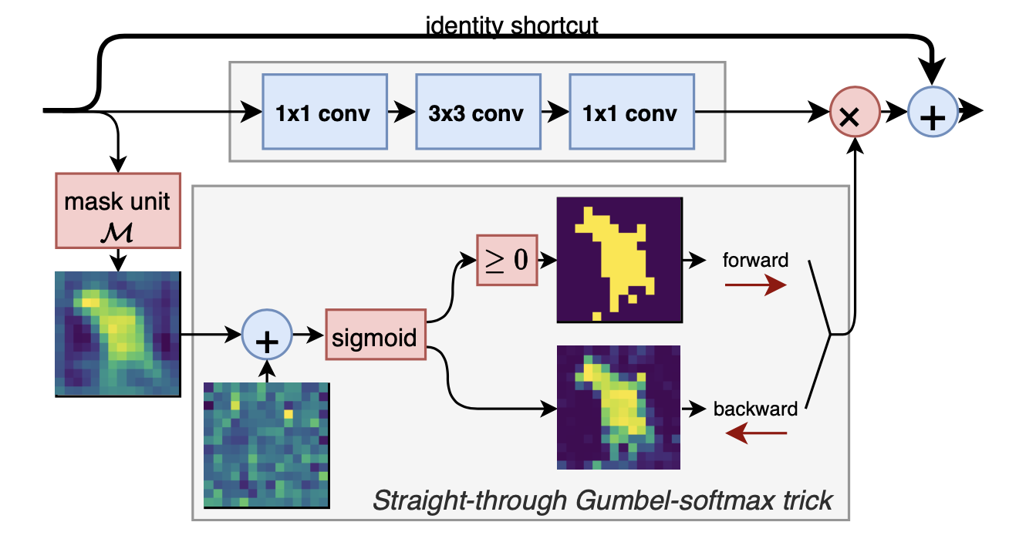
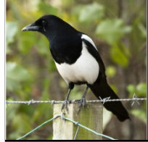

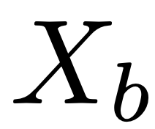




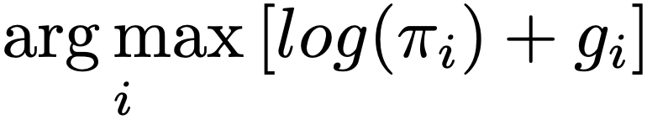
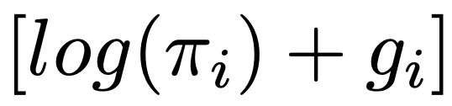


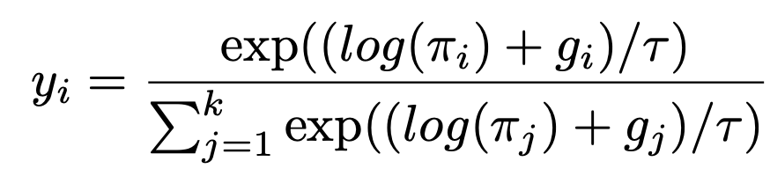
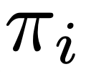
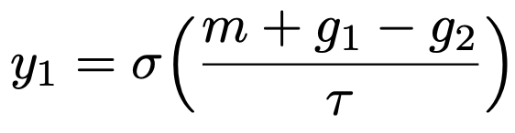

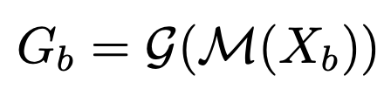

Methods (training):
Traditional Method: direct CNNs (ResNet) ← Feature Extraction
This work: Conditional Spatial Sparse CNNs
Hard decisions
Gumbel-max Sampling: category distribution
Problem:
1. Not a good probability distribution
2. Not continuous, differentiable
Solution: Gumbel-Softmax Sampling
Soft decisions
Class
Trainable
Weights
Simply the equation:
Noise samples
Gumbel distribution
Goal: study the spatial execution masks for an image

Slide 5

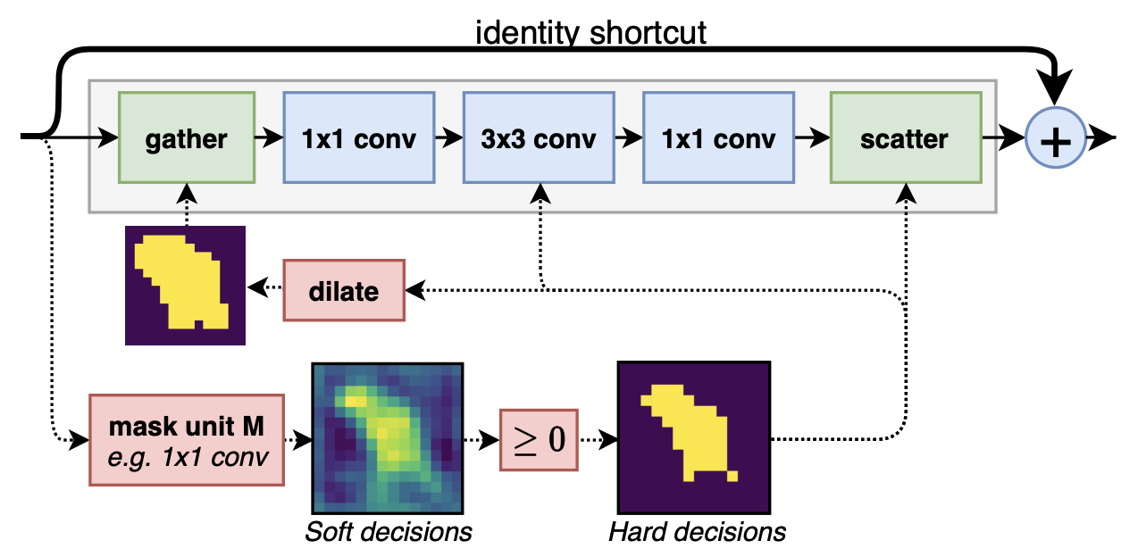






Methods (Inference):
Gather-scatter Strategy
Flatten
Intermediate Tensor
Non-linear Mapping
Avoid gaps
Active spatial positions
spatial neighbors
Reason: Spatial relation lost

Slide 6
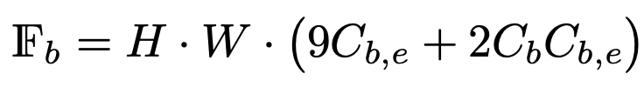
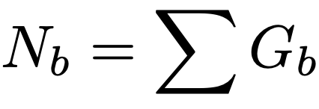
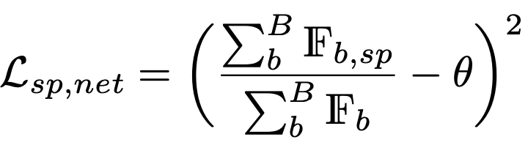
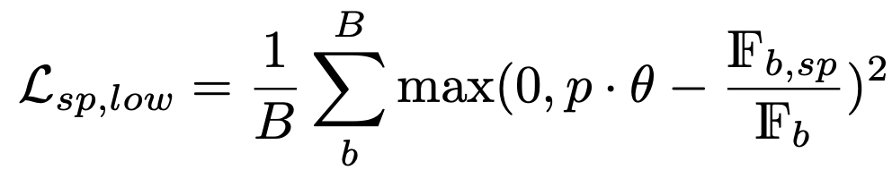

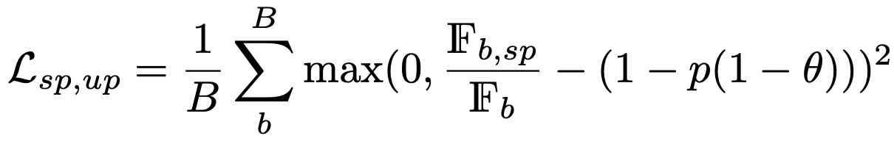

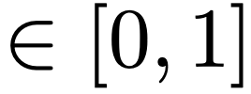
Loss Function: sparsity loss criterion
MobileNetV2：
This Work:
Floating point
Operations Loss

Slide 7
Limitations and Improvements
Limitations:
Applications:
Smaller Objects ← Gather Operation (Flatten)
Multiple Objects
Background Clutter
etc.
Algorithms:
Features cannot be fully extracted ← Region of Proposal (Musk)
Potential Improvements:
Transformers ← Attention Mechanism (Reference: “End-to-End Object Detection with Transformers”)
Fine-grained features extracted methods
If 3D Convolution: Factored Convolution O(N³) → O(N²+N) Speed up

Slide 8
3D Human Pose Estimation by Mixing 2D Image and 3D Depth Triplets Heatmaps

Slide 9
Challenges & Problems:
Lack of Information (Features)
Single Image ← inherent ambiguities
Attention Mechanism
Hard to trade-off between Efficiency and Effectiveness
Representation efficiency
Learning effectiveness
Lack of Training Data
Manual annotation → “In the wild” Images
3D Annotations

Slide 10
Related Work (3D pose estimation based on CNNs):
Direct Encoder-Decoder
Single stage
End-to-end
Transition with 2D Joints
Two stages
2D image → 2D joint locations → 3D space (3D joint locations)
3D-Aware Intermediate States
Two stages
2D image → 3D-aware states → 3D joint locations
Volumetric Representation
* Helpful: Relative depth information (This work: Part-Centric Heatmap Triplets) → Promote Performance

Slide 11
Related Work (3D human body reconstruction based on CNNs):
* Parametric human body space, e.g., SMPL
Two-stage Framework
2D image → 2D joint locations → SMPL
Depth ambiguity → Local minimum
One-stage Framework
2D image → SMPL
Lack of 3D model annotations
Intermediate States
Two stages
2D image → 2D Intermediate states → SMPL
Voxel, Mesh, UV-maps

Slide 12
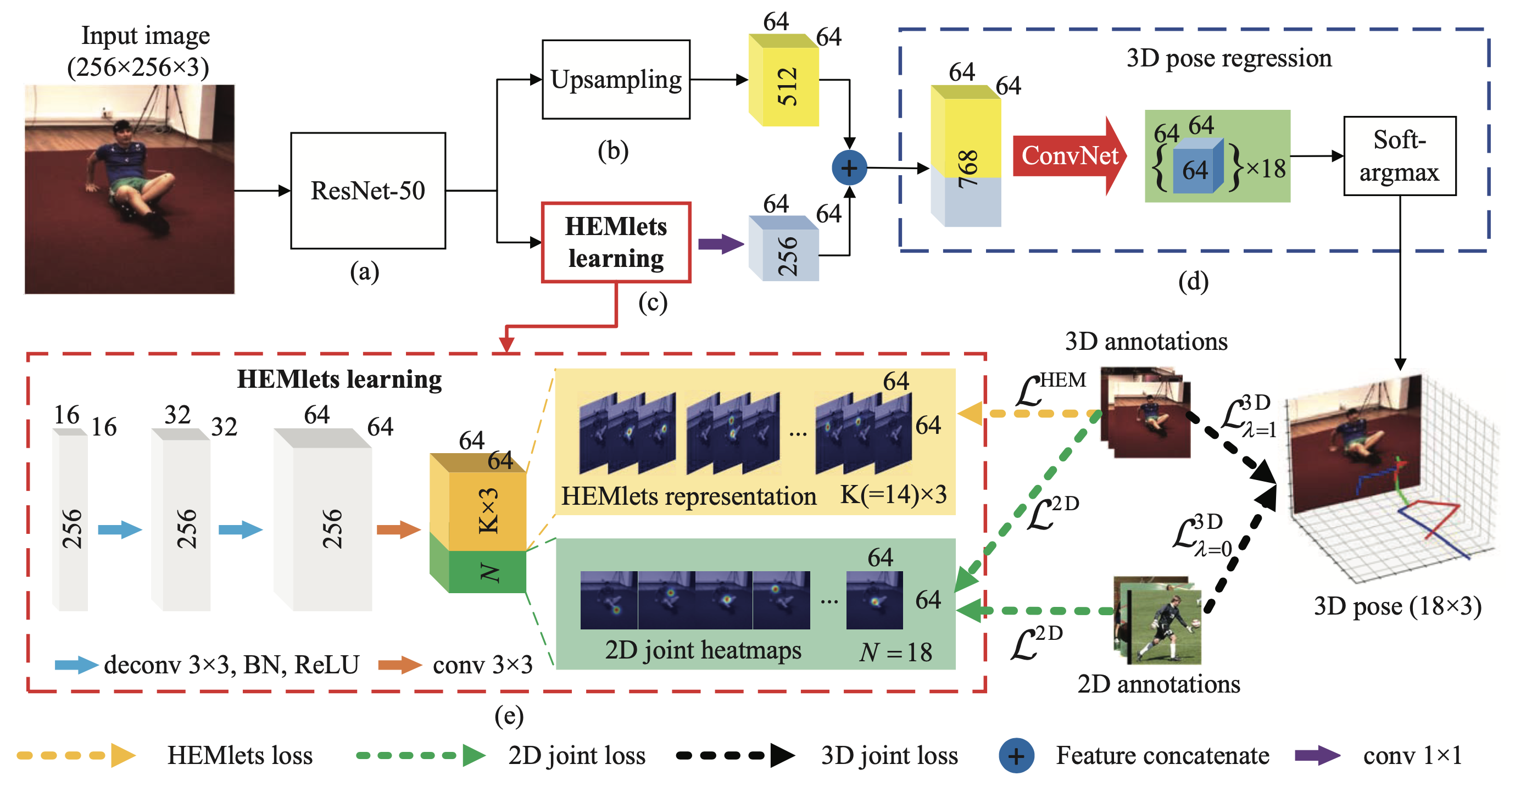
Methods:
global features

Slide 13

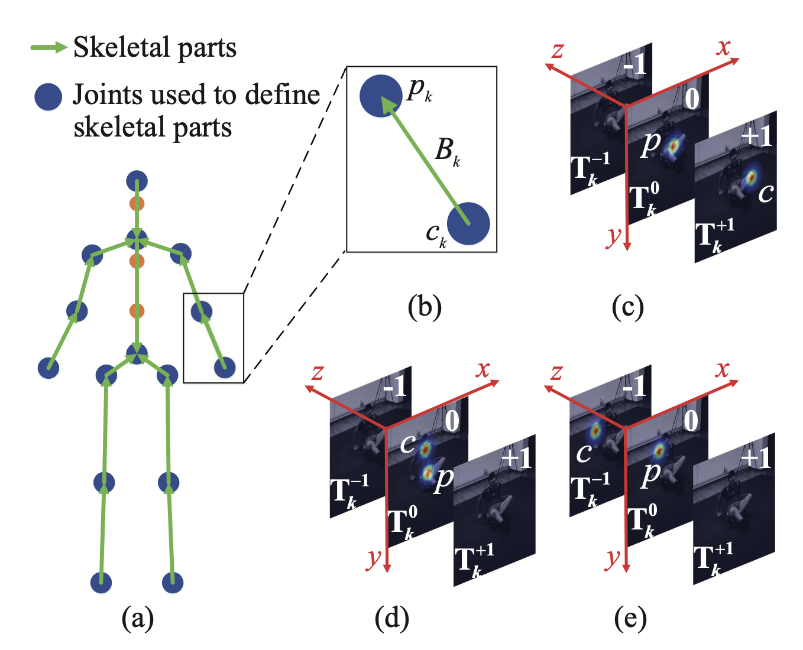
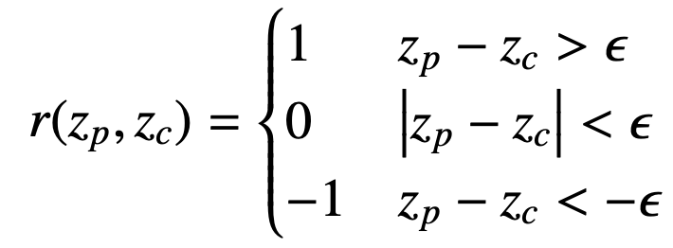


Methods:
Intermediate representation of the 3D-aware relationship
2D Image (coordinates)
Relative depth information ← Part-Centric Heatmap Triplets
p: parent joint
1. Pairwise joints’ co-location likelihoods
2. Depth relations → learn geometric constraints
c: child joint
Relative Depth Ordering
: Relative depth difference

Slide 14
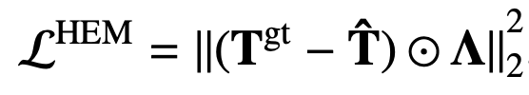
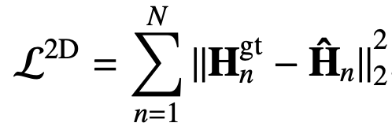
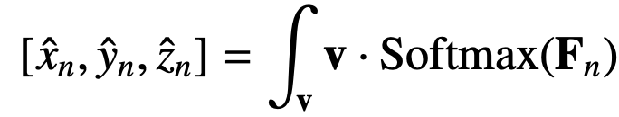
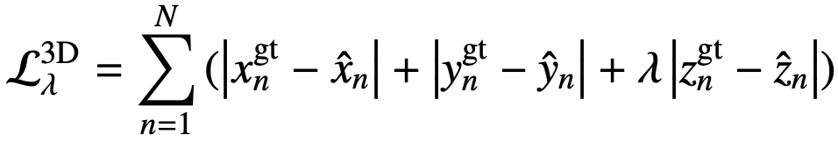


Loss Function:
HEMlets loss:
Auxiliary 2D joint loss:
Soft-argmax 3D joint loss:
3D joints Regression loss:
Training Loss:

Slide 15
Limitations and Improvements
Limitations:
Algorithms:
Heatmaps? ← Region of Interest
Not efficient ← 2D joint annotations and 3D joint annotations
Hard to transfer to other objects ← Too many annotations
Potential Improvements:
Combine the last paper: Spatial Sparse CNNs from Masks → Heatmaps
Depth Information should be considered

